Slide 1
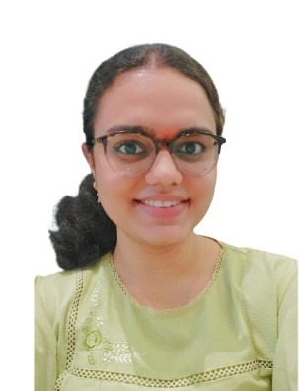



+91 9969054541
2332833@cognizant.com
Bhakti Kharate | LinkedIn
Bhakti Kharate
Areas of Expertise
Skills
JAVA
App Developer
Web Development
Chrome Extension Developer
Java
HTML,CSS, Javascript
Kotlin
SQL
Work experience
Intern
COGNIZANT-INTERN
Training in SDET QEA domain
Education
Shah and Anchor Kutchhi Engineering College, Mumbai, Maharastra
2019-2023
CGPA: 8.82
Language
English
Hindi
Marathi
JAVA
SQL
HTML
CSS

